Slide 1
FIRST
INFORMATION
Presenter: Jen Jura

Slide 2
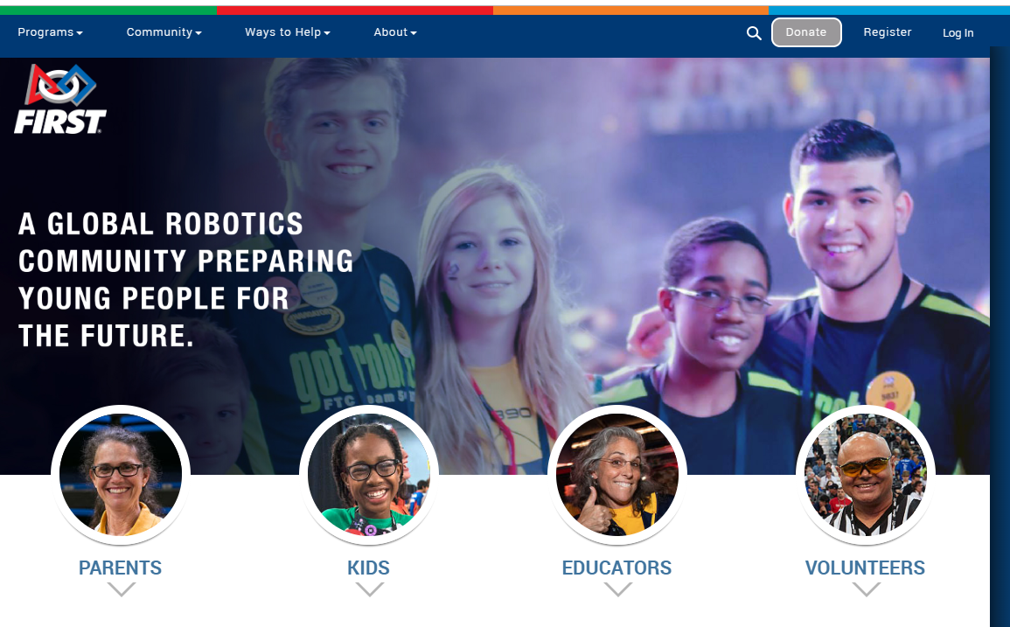
Navigating the FIRST Inspires Website

Slide 3
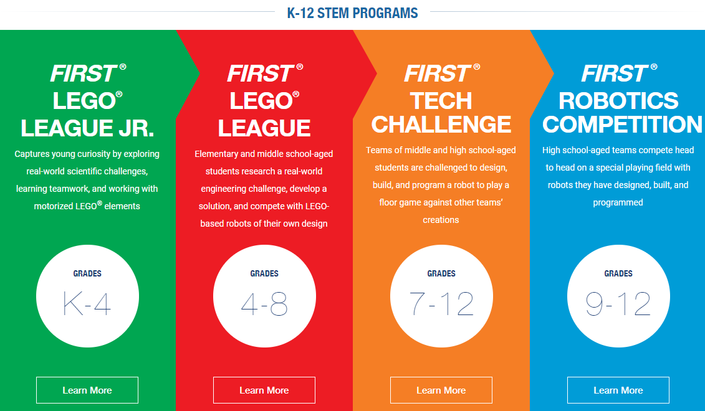
K - 3 4 - 5 6 - 8 9 - 12
Note color-coding for Each level in FIRST
Green: FLL Jr.
Red: FLL
Orange: FTC
Blue: FRC
*Grade Levels in MI...

Slide 4
Easy Access...
Use the pull-down menu for easiest access to the materials that you need…
GAME & SEASON

Slide 5
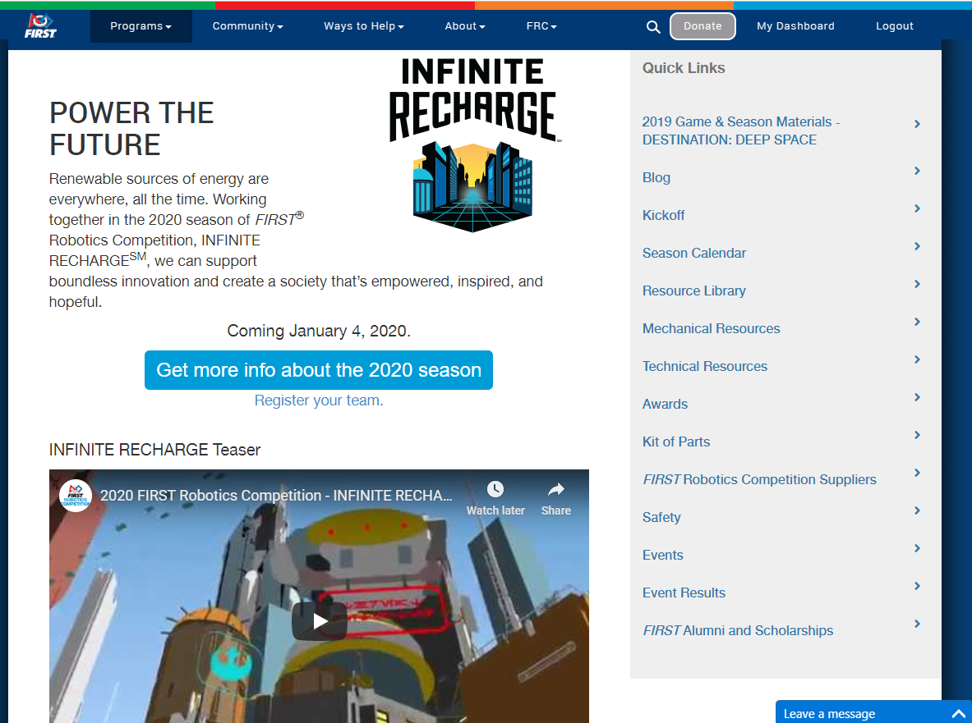
I mostly use…
Game Manual (comprehensive and by section plus weekly updates all in this link)
Awards

Slide 6
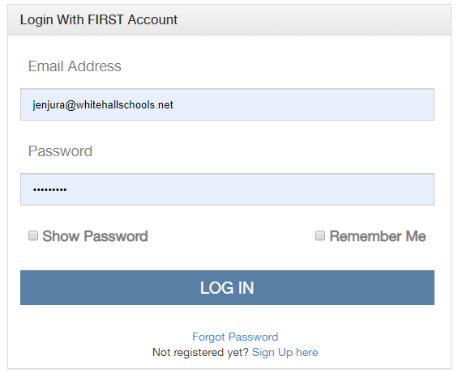
Navigating the FIRST Inspires Dashboard
Start in the top-right corner to get to your DASHBOARD
“Register” to create an account.
or
Log In…
Note: You have to double-click the blue LOG-IN bar.

Slide 7
Coach or Team Administrator… “My Teams” (1st Tab)
Update your Profile, do Consent / Release & Y.P.P.
Watch for numbers in red circles to show what needs to be done...

Slide 8
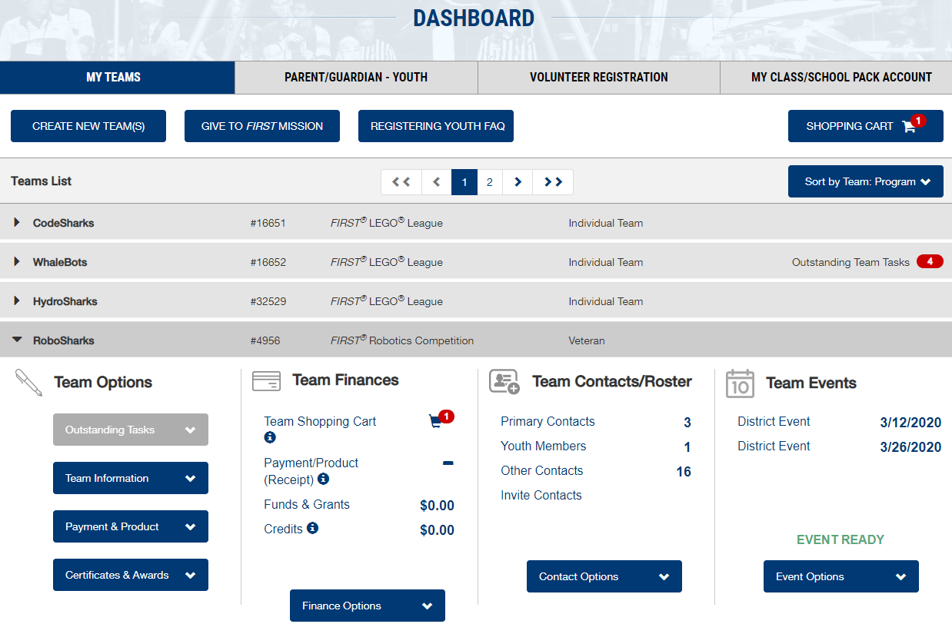
Getting coaches/mentors & students on your team...
Choose the section for Team Contacts/Roster
You can start with one group but it’s just a long list that you can scroll through. Have patience because it takes a little while to “jump” to the place you want to be after each time you do something.

Slide 9
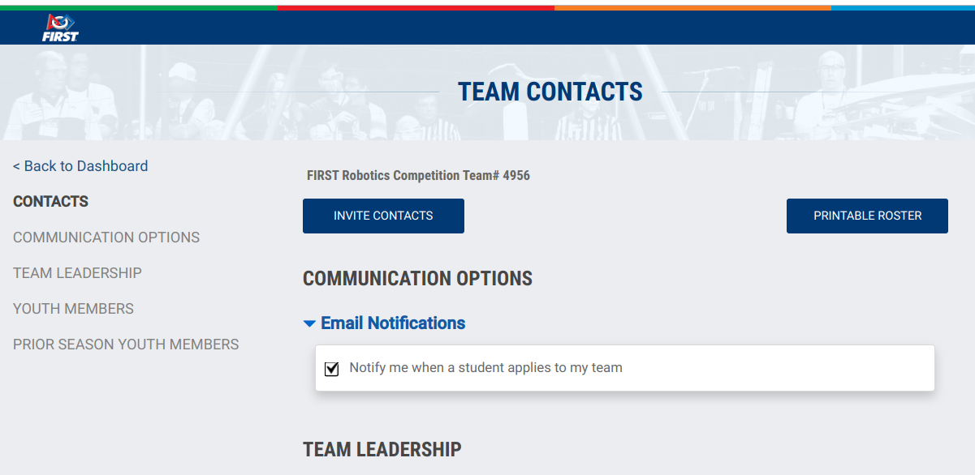
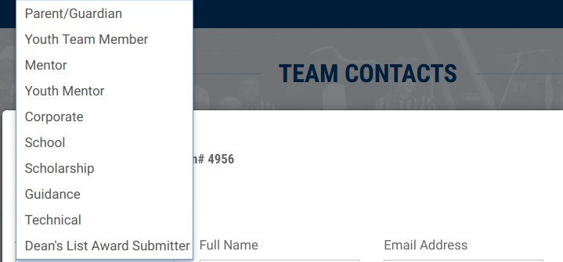
Team Leadership
PRIMARY CONTACTS
Lead Coach/Mentor 1 or 2 has to do most of the “inviting” (& other dashboard stuff).
Team Administrators can only invite Lead Coach/Mentors.
OTHER CONTACTS
Team Mentors or...
Tip - Make sure you have a Team Administrator who can Invite a Lead Coach/Mentor 1 (or 2) if necessary.

Slide 10
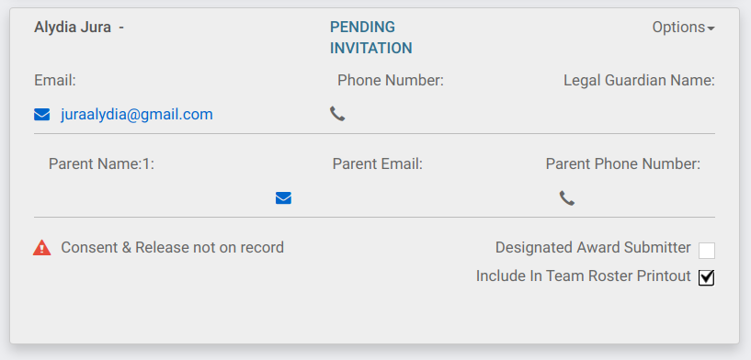
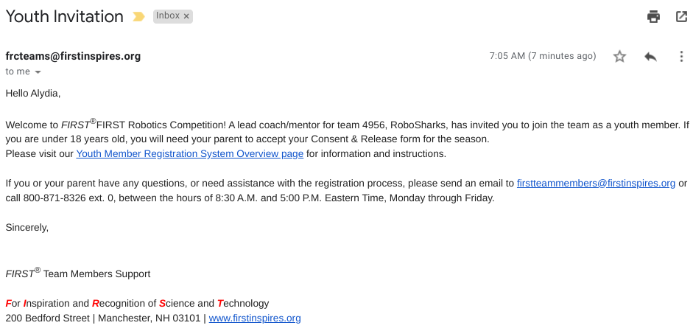
Youth Members (Students)
If a student was on your team last year, you can invite them to join this way…
Then they will be in Pending Invites until they go to their email to accept.

Slide 11
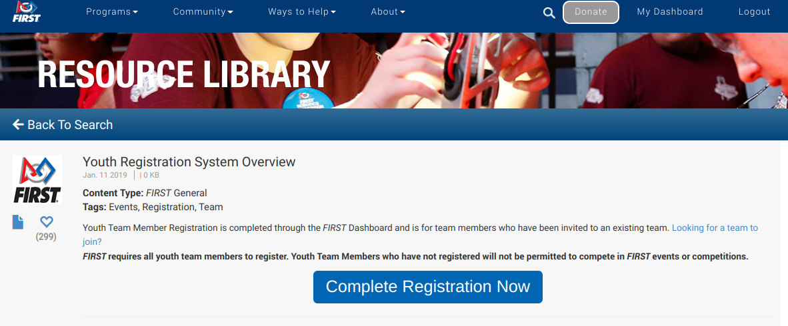
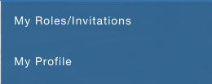
Student View
That e-mail takes them here to “Complete Registration Now”
https://www.firstinspires.org/resource-library/youth-team-member-consent-and-release-form
(This webpage also has lots of helpful links for coaches and parents about registering.)
When they log in, they will need to update their profile then accept their role on your team.

Slide 12
Student View
They will have this red circle by Acknowledgement Forms until their parent/guardian logs in to sign it.
Notes: 1) They have to invite a parent/guardian in this tab (using e-mail).
2) That needs to be done before you print a team roster for kick-off or competitions.

Slide 13
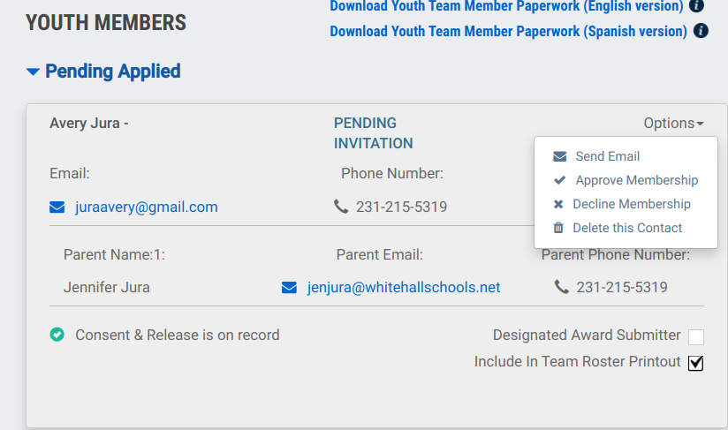
Youth Members (Students)
When a student applies to your team, you have to “approve” them under options.

Slide 14
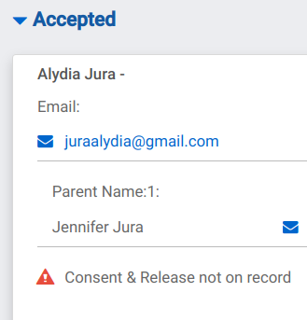
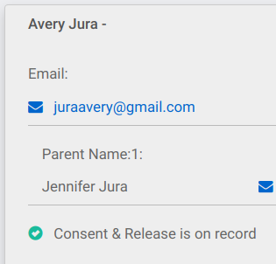
Students (Youth Members)
Regardless of how they get on your team, make sure they get their consent/release forms signed!
Bad
Good

Slide 15
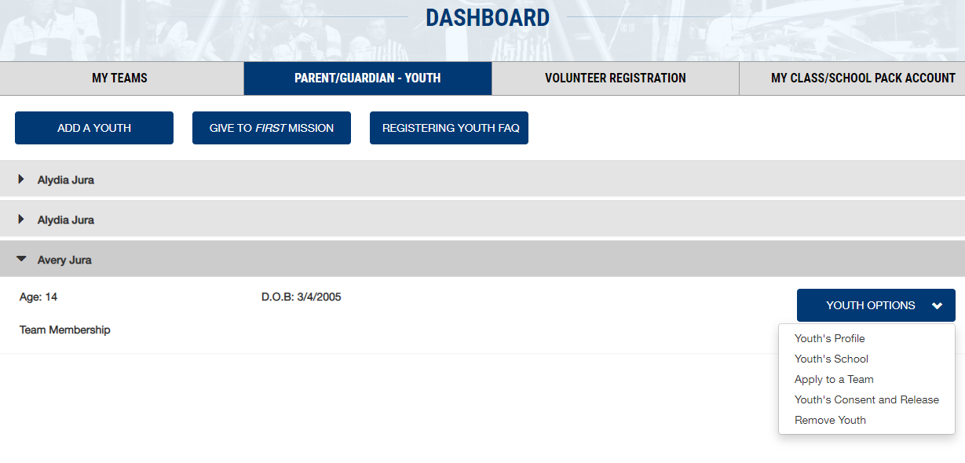
If you are also a parent… (or to help explain to your team members’ parents)
Click over to the 2nd tab to do parent stuff…
Choose from the options in this pull-down menu
Profile, Apply to a Team, & Consent / Release Forms

Slide 16
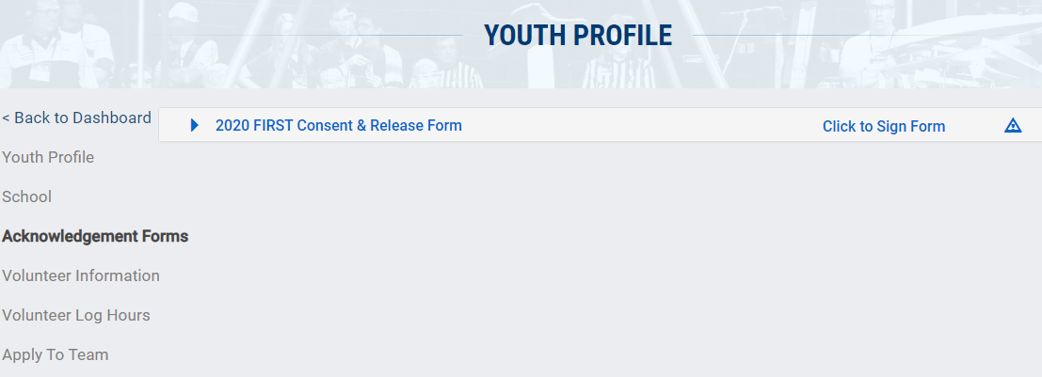
This is often the hard thing to get to work right…
(you will get lots of questions from confused parents)
FIRST in Michigan wants you to do a 2nd Consent/Release form...

Slide 17
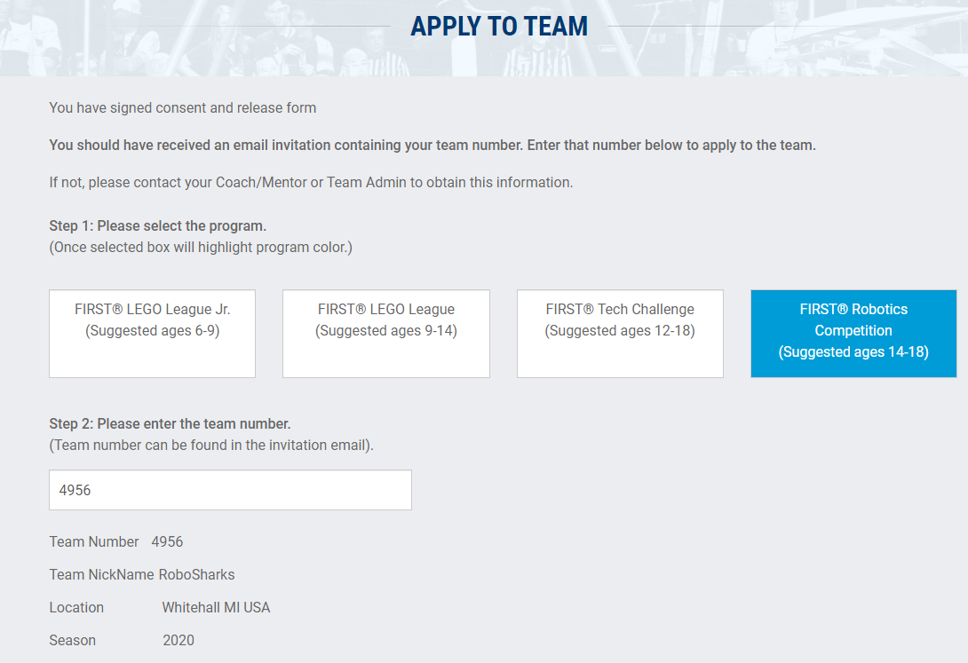
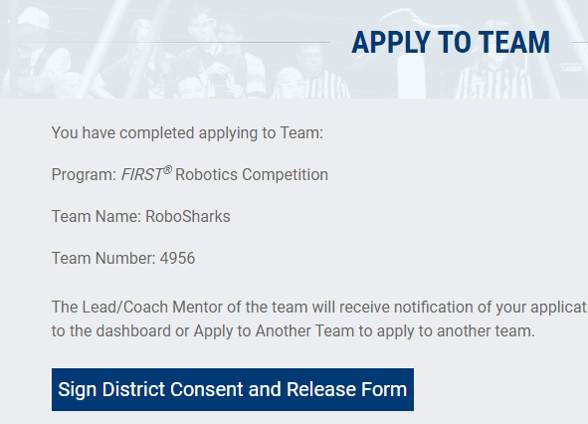
You have to apply to a Michigan team so that the 2nd Consent / Release form will appear.

Slide 18
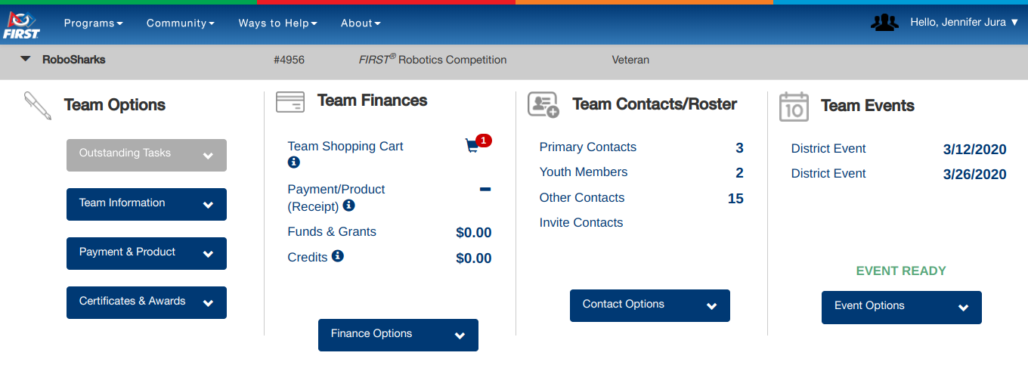
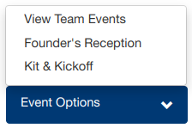
Back to Coach View (My Teams) → Team Events...
Use this section to select your Kick-Off location (= Kit of Parts pick-up location) and your team’s two district-level events.

Slide 19
Team Finances...
This is where you can generate an invoice to ask your school (or other supporting organization) to pay your registration. FIRST grants also appear here. & MORE...

Slide 20
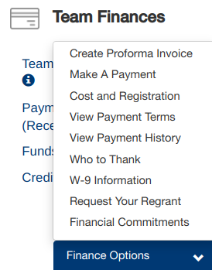
Team Finances… more details
Invoices:
You can pay for several teams at once if your organization supports FLL Jr, FLL &/or FTC also.
There are variations in payment methods & what is covered by registration (next slide)
W-9 Information:
Upload W9 form from school to qualify as tax-exempt
Request Your Regrant:
If you have grant $ above registration fees, you can apply here to have them send you a check.
Notes:
non-FRC teams also have a Sales Tax Exemption form that needs to be filled out and uploaded.

Slide 21
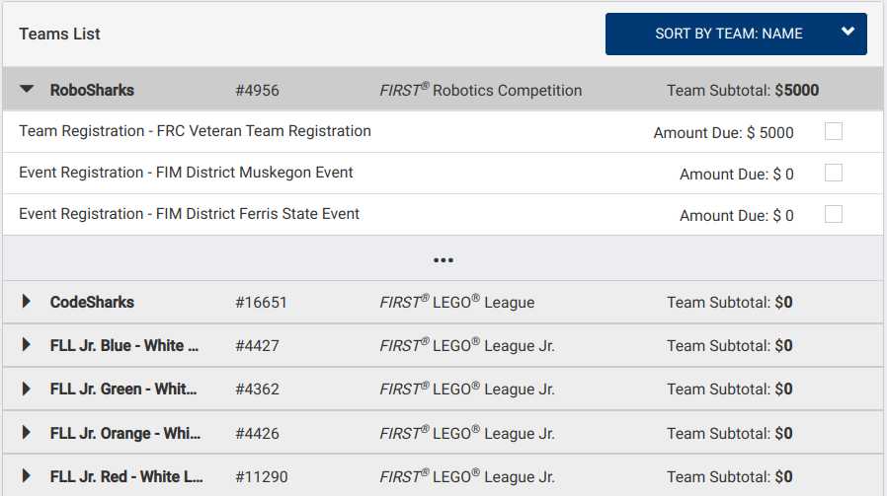
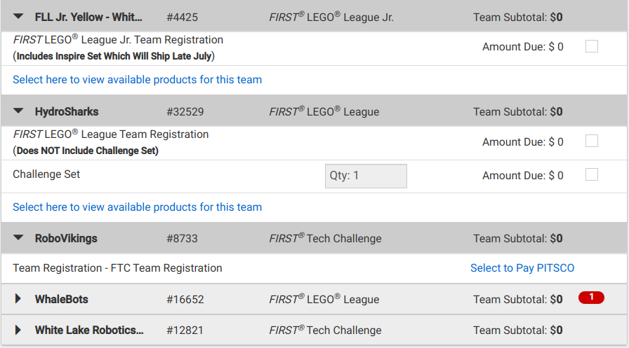
Team Finances…
Invoices - Payment Variations
FLL Jr. - registration includes Student Notebooks & Lego kit.
FLL - registration is only Student Notebooks & Mentor Guide Challenge Set is an additional $75 per year
FTC - Pay registration through PITSCO (can’t combine w/ others)
FRC - registration includes 2 District Events + Kit Of Parts

Slide 22
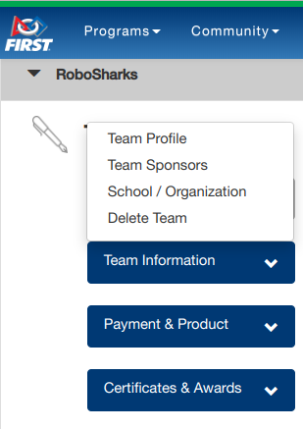
Team Options...
Team Information:
Team Profile - Team Name & Location, Website, Robot Name & Mentoring Information
Team Sponsors School / Organization Note - official team name includes these sponsors and school

Slide 23
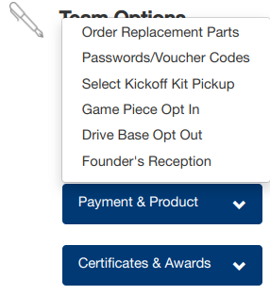
Team Options...
Payment & Product:
Note - at FLL & FTC levels, only “order product”
Order Replacement Parts (from the KoP)
Passwords / Voucher Codes - lots of FREE stuff!
Kickoff Location = Kit of Parts Pick-up Location*
Do you want to build your own Chassis???
Do you want to visit Dean Kamen’s house in NH?* (adults only)
*Also options in the events section

Slide 24
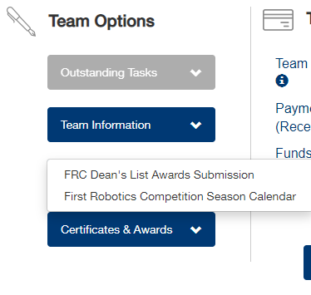
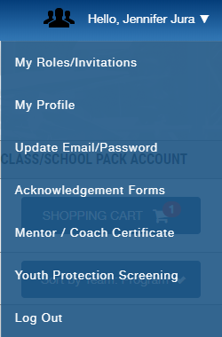
Team Options...
Certificates & Awards:
Dean’s List - Lead Coach/Mentor 1 or 2 may nominate up to 2 students for this award.
Season Calendar - shows due dates for award submissions
*Note: The Mentor/Coach Certificate is available up top by your name & profile info. (not here).

Slide 25
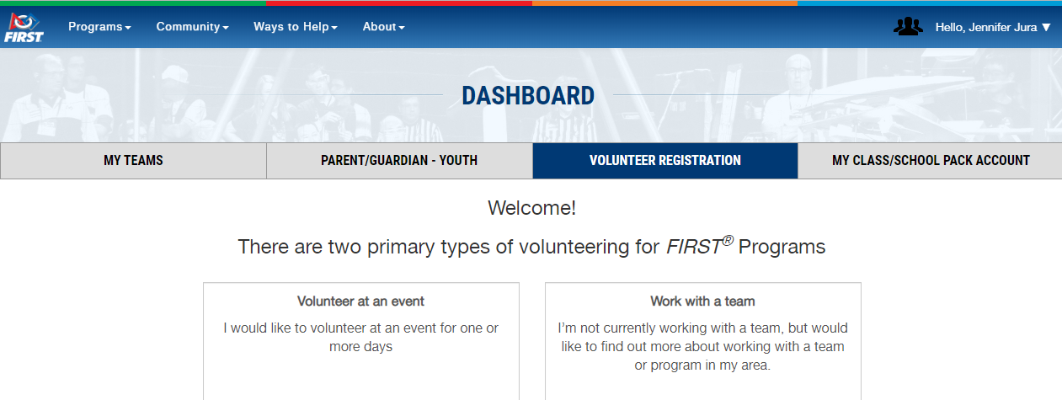
“Volunteer Registration” (3rd Tab)
Choose this option
Volunteers have to create an account, do Consent / Release, etc. They must be at least 14 years old.

Slide 26
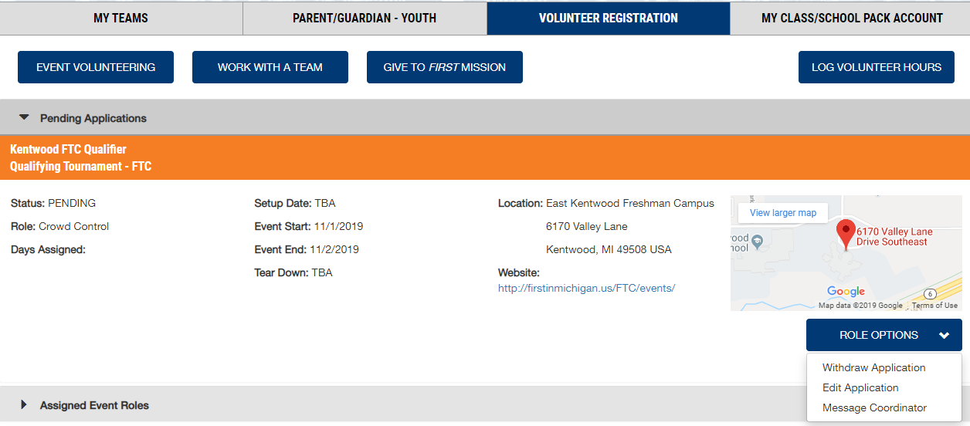
“Volunteer Registration” continued...
Apply for another event here
Options after filling out the application...
Withdraw Application Edit Application Message Coordinator
Your assigned role & other info. can be found here.

Slide 27
Final Reminders...
Remember to double-click the “LOG-IN” button.
Watch for red circles (or words) if something major needs to get done.
Have patience and the website will “jump” to the place you left off.
Students must be signed up for a Michigan Team in order to get access to the Michigan Consent/Release form. (They NEED to get both done before kick-off!)

Slide 28
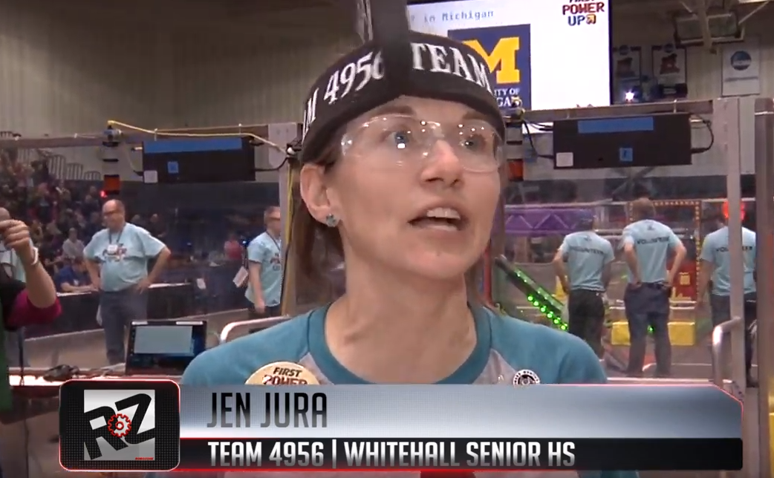
Questions or Comments?
If we have extra time, let’s check out these other great resources:
Chief Delphi - great place for technical questions
The Blue Alliance - comprehensive results of competitions
Robozone TV - inspiring videos & TV shows (include my interview from FIRST Power UP in 2018)

Slide 29
FIRST
INFORMATION
Presenter: Jen Jura

